Slide 1
2D Numerical Study of Nonlinear Magnetic Reconnection
Dingyun Liu
APC523 2022 Spring

Slide 2
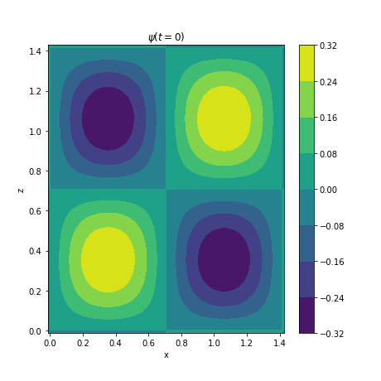
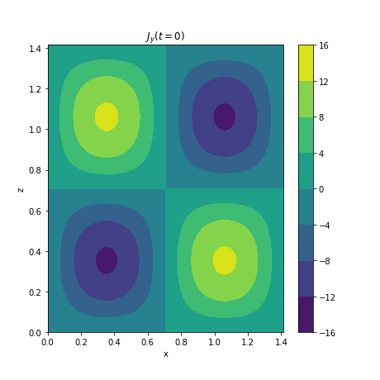

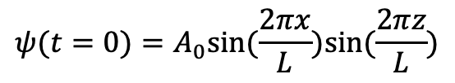
1. Initial Equilibrium
$$ψ(t=0)=A_{0}sin⁡(\frac{2πx}{L})sin⁡(\frac{2πz}{L})$$
$$J_{y}=∇^{2}ψ$$

Slide 3
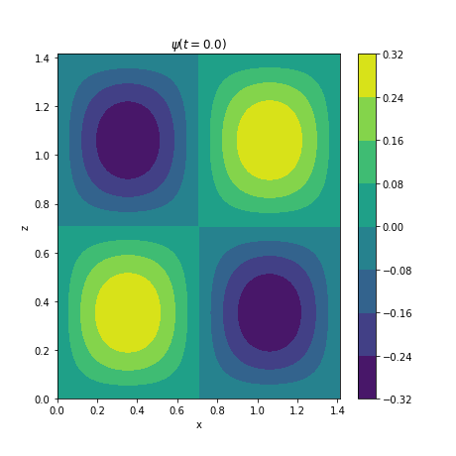

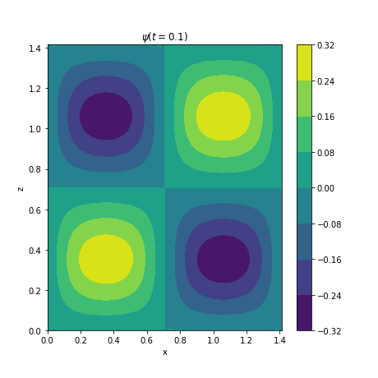
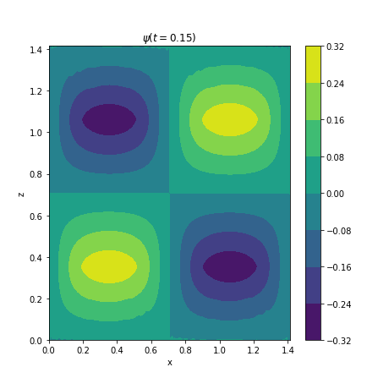
2. Sample Results: Leap-Frog Scheme
Flux functions at t=0.0, 0.05, 0.10, 0.15

Slide 4
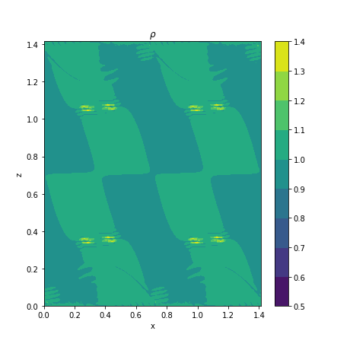
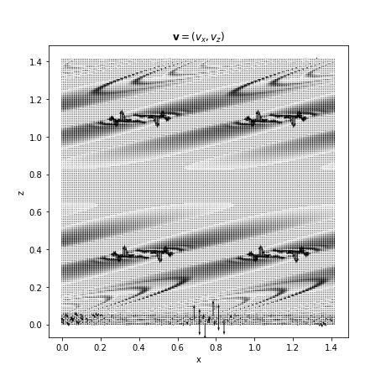
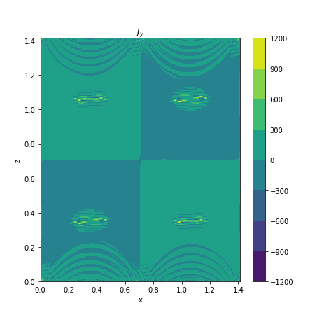
2. Sample Results: Leap-Frog Scheme
Density $ρ$, velocity $v$, and y component of current density $J_{y}$ at t=0.15. The density is not uniform anymore, and some peaks appeared in each flux tube. The velocity field is highly stratified. The contour of $J_{y}$ shows that current sheets have been formed in each flux tube, and there are dramatic oscillation on the boundaries. We can't see any plasmoid instability developing yet

Slide 5
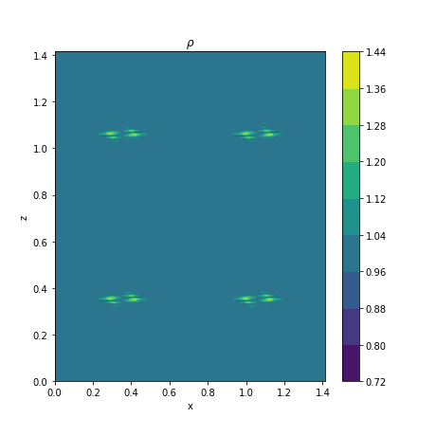
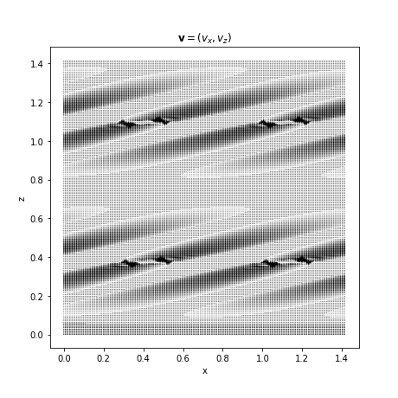
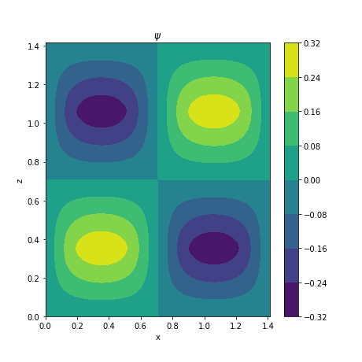
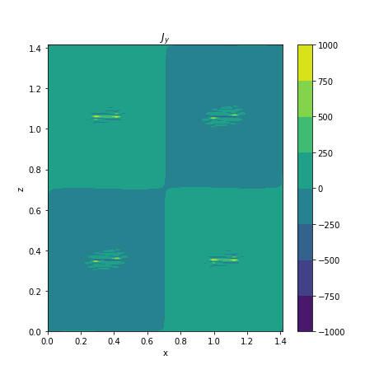
2. Sample Results: Symplectic Euler Scheme
Density $ρ$, velocity $v$, flux function $ψ$, and y component of current density $J_{y}$ at t=0.15. Results are almost consistent with those from the leap-frog scheme, with smaller influence from the boundaries.

Slide 6
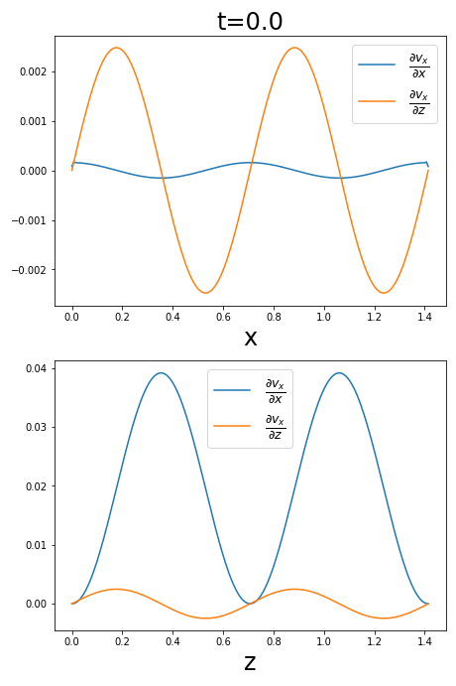
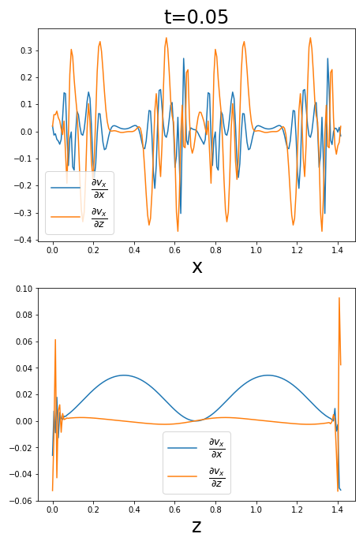
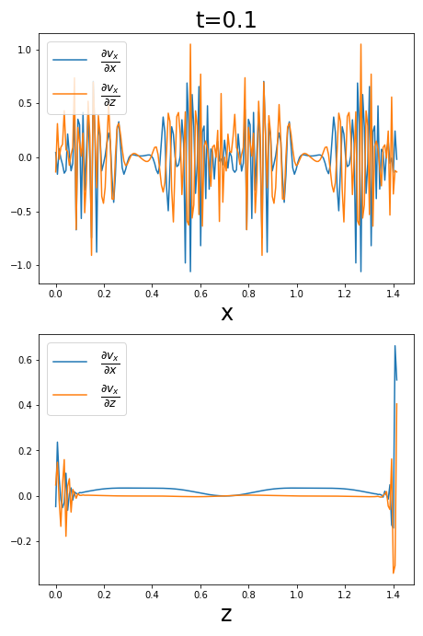
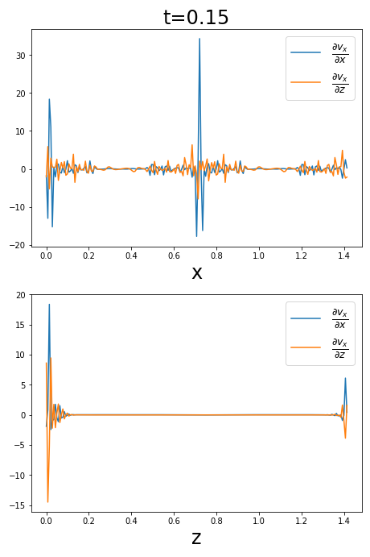
3. Problems at the Boundary
Cross sections of $\frac{∂v_{x}}{∂x}$ (blue) and $\frac{∂v_{z}}{∂z}$ (orange) on the z=0 (top) and x=0 (bottom) boundaries at t=0.0, 0.05, 0.10, 0.15 in the leap-frog scheme. The partial derivatives blow up at the boundaries at $z=0, \sqrt{2}$, driving the $ρ$ field negative.

Slide 7
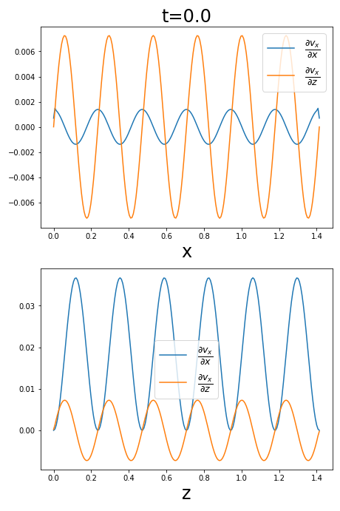
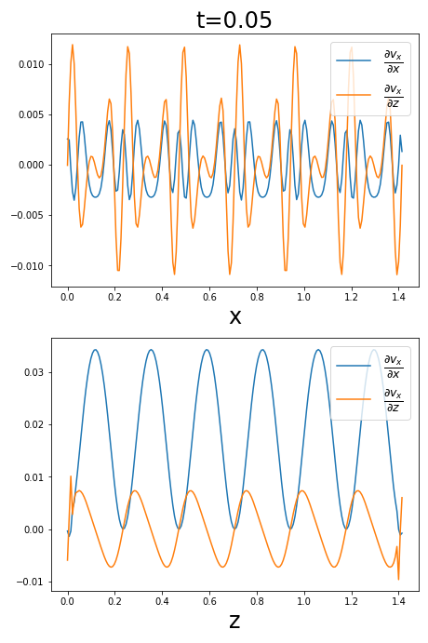
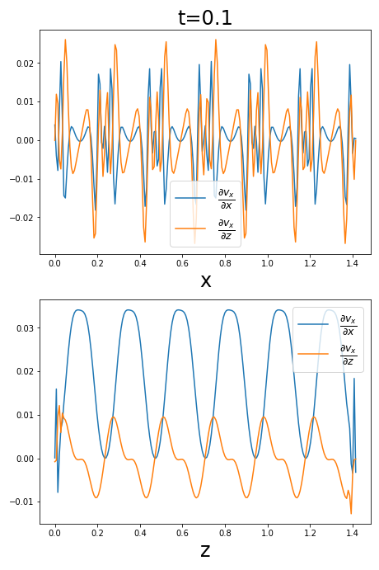
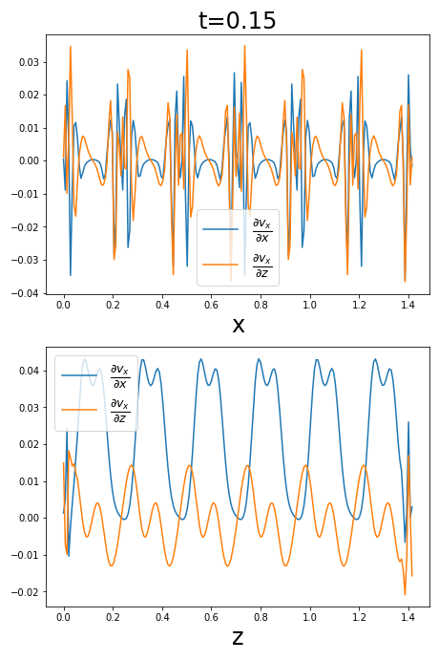
3. Problems at the Boundary
Expand the simulation region in the leap-frog scheme. The partial derivatives still blow up, but they become periodic, and the oscillation amplitude gets smaller at the same instance. The influence of the boundaries decreases with the expansion.

Slide 8
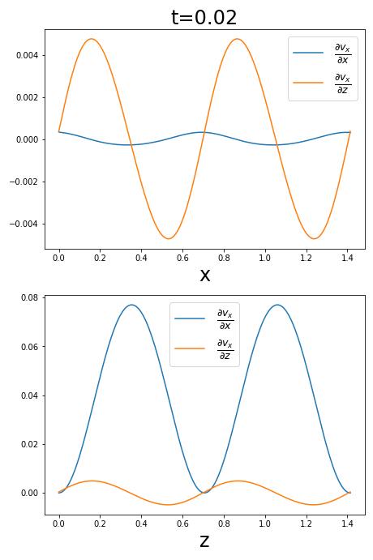
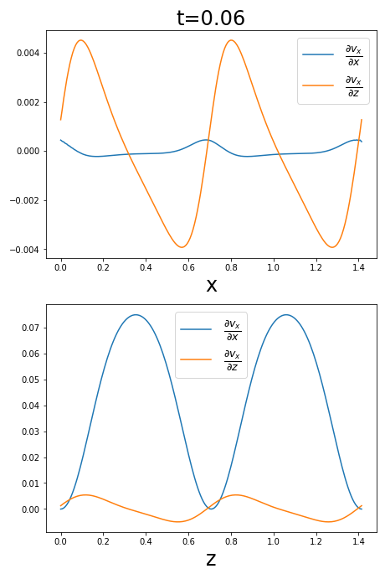
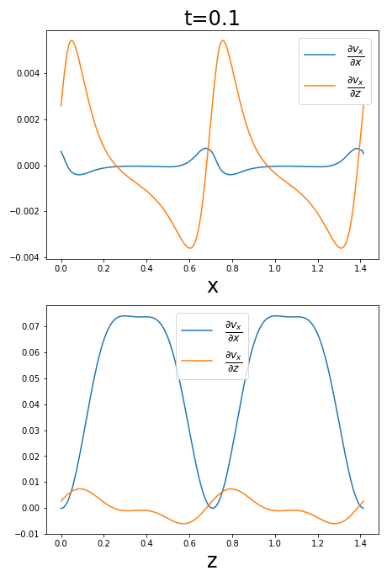
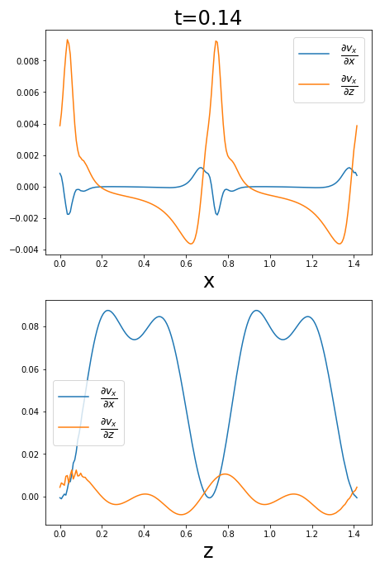
3. Problems at the Boundary
In the symplectic Euler scheme, while the fields also blow up rapidly, the boundaries behave better. $\frac{∂v_{x}}{∂x}$ ($\frac{∂v_{z}}{∂z}$) oscillates weakly in x (z) direction but strongly in z (x) direction. There are only small wiggles on the one end of the boundaries in z direction

